Slide 1
1. Introduction to Microprocessors
1.1 Hardware Components and Von Neumann Architecture
1.2 Fundamental Concepts of Programs
1.3 Other Computer Architectures
1.4 Embedded Systems

Slide 2
1.1 Hardware Components Von Neumann Architecture
Von Neumann Architecture - basic computer architecture
functional components include
Processing Unit for Computations
Input Device(s) to enter data
Control Unit to oversee performance of other components
Output Devices for data to exit the computer
KBD
Display
Input
Mouse
Memory
Network
Output
Hard Drive
Hard Drive
Processing Unit
ALU
Registers
Control Unit

Slide 3
Von Neumann Architecture
starting point for understanding more complex architectures
all architectures have same basic components
differ in number, complexity, and interconnection of components
Other Architectures
CISC: complex instruction set computer
RISC: reduced instruction set computer
Super Scalar: multiple computational units within a CPU
Multi Core: multiple processing cores integrated with shared memory

Slide 4
Hardware Components Von Neumann Architecture
Memory
KBD
I/O
code
data
display
network
Memory: stores code and data
CPU:
reads instructions and data from memory
stores data on CPU registers
performs operations on data
writes data to memory
I/O
receives data from external sources (e.g. keyboards, network)
sends data to external sources (e.g. display, network)
CPU

Slide 5
Address, Data, Control Lines
16 bit address lines designate target memory cell
8 bit data lines carry data associated with memory cell
R/W control line
R = memory contents are transferred to CPU
W = CPU writes data to memory location
Memory
control
address
d₇ … d₀
data
R/W
CPU
A₁₅ … A₁ A₀
D₇ D₆… D₀

Slide 6
Memory & I/O Separately Mapped
Memory Mapped I/O
Memory
Memory
code
data
code
data
KBD
I/O
KBD
display
CPU
I/O
display
network
network
CPU
Memory and I/O have separate address space and address bus
Memory and I/O share same address space and address bus

Slide 7
Simplified CPU Block Diagram
Memory
code
data
KBD
I/O
display
network
CPU
cache
control registers
ALU
arithmetic/logic operations
data register
FPU
floating point operations

Slide 8
1.2 Fundamental Concepts of Programs
(1) Program Concepts
(2) Instructions & Instruction Cycle
(3) Machine Language & Assembly Language Concepts
Conventions:
“$” is used to indicate HEX value
$FE = 254 (decimal) = 1111 1110 (binary)
$FF = 255 (decimal) = 1111 1111 (binary)
$100 = 256 decimal = 1 0000 0000 (binary)
($300F) refers to the contents of memory location (address) $300F
($300F) = $C8
Address | Instruction
$300F | 11001000

Slide 9
Background
Machine Code
binary language developed in early computers
consisted of opcodes and operands 1011 0110 1101 0000
actual code that is executed on a CPU
Assembley Language (AL)
derived from machine code using a software tools called an ASSEMBLER
allows humans to easily read machine language
requires knowledge of CPU hardware, memory access, device interfaces
High Level Languages (HLL)
allows the user to view the CPU as an abstraction
executes logical instructions (e.g. conditional logic and loops)
details of CPU components and memory access modes are largely hidden
results in portable code that is easy to understand (ha ha ha)
e.g. machine code B6 D0 00 translates to assembly language as LDAA $D000
- it means “load register A with the value stored in memory location $D000”
- a HLL instruction is composed of several assembly level instructions

Slide 10
Example of Add Operation
High Level Language:
A = A + B
no knowledge of CPU/memory required
portable to different operating systems/CPU
trivial to understand
Assembly Language
LDAA $D000
ADDA $D001
STAA $D000
not portable
requires knowledge of CPU and memory
non-trivial understanding
Machine Code
B6 D0 00 = 1011 0110 1101 0000 0000 0000
BB D0 01 = 1011 1011 1101 0000 0000 0001
B7 D0 00 = 1011 0111 1101 0000 0000 0000
machine dependent, difficult to understand

Slide 11
(1) Program Concepts
An executable program is a sequence of simple instructions stored in memory
CPU processes each instruction (goes through an instruction cycle)
most instructions are processed sequentially
some instructions cause the CPU to jump ahead or backwards in memory for the next instruction
Programs and data reside in memory
Address | Instruction
$8000
$8002
$8004
$8006
$8008
$800A
$800C
$800E
$8010
SEQUENTIAL
JUMP BACKWARDS
JUMP FORWARD

Slide 12
Program Concepts
each instruction goes through an instruction cycle
instruction fetch(IF)
decode (De)
operand fetch (OF)
execute (Ex)
Address | Instruction
$8000
$8002
$8004
$8006
$8008
Fetch
Instructions
CPU
Address | Data
$A000
$A002
$A004
$A006
$A008
Fetch/Store Data
instruction
IF
De
OF
Ex
IF
De
OF
Ex
IF
De
OF
Ex

Slide 13
(2) Instruction & Instruction Cycle
Read and Write Cycle
Structure of an Instruction
Instruction Cycle
(2.1) Read and Write Cycle
signal transitions have distinct states over time
requires timing for moving between CPU and memory
rise time
falling edge
rising edge
CPU clock drives all cpu functions
bus clock for address and data transfers runs at a fraction of the CPU clock rate (bus clock period is a multiple of cpu clock)
R/W line, address valid, and data valid signals are driven off cpu clock transitions

Slide 14
Write Cycle: transfer Data from CPU to memory/output device
CPU clock
Bus Clock
1
2
Address Valid
R/W
3
6
Write
5
Data Valid
4
1. bus clock rate is a fraction of CPU clock rate
2. initiate write operation → CPU places address on address bus - assert address valid after clock transition
3. assert R/W line to ‘Write’ state
4. Data put on data bus – assert data valid one cpu cycle after address is valid
5. Write signal sent to RAM or remote device – RAM or device latches data on data bus
6. de-assert R/W, write, address valid, and data valid

Slide 15
Read Cycle: Transfer Data from memory/device to CPU
CPU clock
Bus Clock
Address Valid
1
R/W
2
5
Read
4
Data Valid
3
1. initiate read operation → CPU places address on address bus - assert address valid after clock transition
2. assert R/W line to ‘Read’ state
3. Data put on data bus – assert data valid one cpu cycle after address is valid
4. Read signal set, read operation performed after data is valid and R/W set
5. de-assert R/W, read, address valid, and data valid

Slide 16
(2.2) Structure of an Instruction
ASM Instruction Format
LABEL MNEUMONIC OPERAND1, OPERAND2,…
LABEL = logical pointer to instructions address (memory location) – used by branch and jump instructions
MNEUMONIC = logical representation of machine Opcode (e.g. ADD, LOAD, STORE)
OPERAND(s) = data to modified
data can be constant or variable
data can be stored in a CPU register or memory
Addressing Modes define how to access operands
Common Categories of Machine Instructions
load & store (read & write)
logic operations (comparison, XOR, OR, AND, NOT)
arithmetic operations: add, subtract, multiply, divide

Slide 17
(2.3) ASM Instruction Cycle
refers to the execution of a machine code instructions by CPU
an instruction consists of 4 fundamental operations
(1) Instruction Fetch
(2) Decode the instruction
(3) Operand Fetch
(4) Execute
operations (1), (2), and (3) consist of read/write cycles

Slide 18
ASM Instruction Cycle (cont)
1. Instruction Fetch (2 clock cycles)
Program Counter (PC) contains address of next instruction to be executed
FETCH instruction from memory & stored in CPU’s Instruction Register (IR)
PC is updated to the address of the next instruction
2.Decode the instruction (1 clock cycle)
decoder interprets the instruction contained in the IR
determines how many operands and addressing modes
3. Operand Fetch
location of operand(s) is determined
FETCH operand from memory to CPU data registers
number of clock cycles depends on addressing mode (one-three is typical)
4. Execute
operand(s) are manipulated by relevant units of the CPU
result of the operation is written to memory or output device
PC may be updated

Slide 19
1. Instruction Fetch (2 clock cycles)
PC points to next instruction
instruction is stored in IR
PC updated to next instruction
CPU
CPU
PC
$8000
DR-1
PC
$8003
DR-1
3
IR
Mne
DR-2
DR-2
IR
Mne
2
Address | Instruction
$8000 | mnemonic
$8001 | operand 1
$8002 | operand 2
$8003 | mnemonic
$8004 | operand 1
$8002
1

Slide 20
2. Decode the instruction (1 clock cycle)
CPU
PC
$8003
DR-1
Operand 1
IR
Mne
DR-2
Operand 2
1
Decoder
ALU
FPU

Slide 21
3. Operand Fetch
determine operand(s) location
fetch/store operands in data registers
CPU
PC
$8003
DR-1
Operand 1
IR
Mne
DR-2
Operand 2
Decoder
ALU
FPU
1
Address | Instruction
$8000 | mnemonic
$8001 | operand 1
$8002 | operand 2
$8003
$8004
$8002

Slide 22
4. Execute
operand(s) are manipulated by CPU
result stored to memory/output device
PC may be updated
CPU
DR-1
Operand 1
3
PC
$80AE
DR-2
Operand 2
IR
Mne
1
Decoder
ALU
FPU
2
Address | Instruction
$8000 | mnemonic
$8001 | operand 1
$8002 | operand 2
$8003
$8004 | result
$8002

Slide 23
Instruction Cycle and Pipelines
each step in the cycle operates independently
pipelines execute different steps in parallel
significant increase in processing speed
Memory
CPU
Inst. Fetch
OPR
Fetch
Decoder
EXE
Linear Instruction Cycle
IF 1
DE 1
OF 1
EX 1
IF 2
DE 2
OF 2
EX 2
IF 3
DE 3
OF 3
EX 3
t
Pipelined Instruction Cycle
IF 1
DE 1
OF 1
EX 1
IF 2
DE 2
OF 2
EX 2
IF 3
DE 3
OF 3
EX 3
t

Slide 24
(3) Machine Language & Assembly Language Concepts
accumulator (ACC) is a type of data register on the CPU
CPU
Example 1
A
A4
Machine Language Instruction B6 D0 00
PC
$8000
B
IR
B6
PC = $8000
CPU fetches & decodes ($8000) = B6
Decoding reveals operands at ($8001),($8002)
CPU fetches operands $D0 and $00
instruction B6 D0 00 is executed
B6 causes ($D000) to load into register A
(A) = ($D000) =$A4
Decoder
ALU
FPU
Address | contents
$8000 | B6
$8001 | D0
$8002 | 00
$8003
$8004
… | ….
$D000 | A4
$D001 | FE
Assembly Language Instruction
B6 D0 00 is translated as LDAA $D000

Slide 25
Example 1 (cont)
CPU
Machine Language Instruction BB D0 01
A
AA
PC
$8003
PC = $8003
CPU fetches & decodes ($8003) = BB
Decoding reveals operands at ($8004),($8005)
CPU fetches operands $D0 and $01
instruction BB D0 01 is executed (Add)
BB causes ($D001) to add with (A)
(A) = (A) + ($D001) =$A4 + $06=$AA
B
IR
BB
Decoder
ALU
FPU
Address | contents
$8000 | B6
$8001 | D0
$8002 | 00
$8003 | BB
$8004 | D0
$8005 | D1
… | ….
$D000 | A4
$D001 | 06
Assembly Language Instruction
BB D0 01 is translated as AddA $D001

Slide 26
Example 1 (cont)
CPU
Machine Language Instruction B7 D0 02
AccA
AA
PC
$8006
AccB
IR
B7
PC = $8006
CPU fetches & decodes ($8006) = B7
Decoding reveals operands at ($8007),($8008)
CPU fetches operands $D0 and $02
instruction B7 D0 02 is executed (Store)
B7 causes (A) to be stored in $D002
($D002) = (A) =$AA
Decoder
ALU
FPU
Address | contents
$8000 | B6
$8001 | D0
$8002 | 00
$8003 | BB
$8004 | D0
$8005 | D1
$8006 | B7
$8007 | D0
$8008 | 02
… | ….
$D000 | A4
$D001 | 06
$D002 | AA
Assembly Language Instruction
B7 D0 02 is translated as STAA $D002

Slide 27
Early Computers (194x)
programs were written in binary and stored on paper tape
“machine code” instructions consisted of opcodes and operands
10110110 11010000 00000000
hex is a compact form of binary
B6 D0 00 = 10110110 11010000 00000000
Assembly Language evolved to make machine language understandable
mnemonics replaced opcodes
symbolic names replaced explicit memory locations
LDAA replaced B6
DATA1 replaced 11010000 0000000
10110111 11010000 00000000 becomes LDAA DATA1

Slide 28
Assembler translation steps
demo.lst
program
Listing
file
(Machine Code Listing
View in Notepad
demo.asm
AL
source
code
assembler
demo.s
executable
Program
file
download
(L T command)
using terminal program
HCS12 board
Board
written in TEXT EDITOR
(Execute with
G command)
(downloaded to the Evaluation board )

Slide 29
1.3 Other Computer Architectures
(1) Reduced Instruction Set Computing (RISC) Processors
(2) Complex Instruction Set Computing (CISC) Processors
(3) Super Scalar Architectures
(4) Multi Core Architectures

Slide 30
(1) RISC Overview
a RISC CPU designed to execute simple instruction set
goal is to complete each instruction in one clock cycle
complex commands are broken into multiple simple instructions
load, store, processing operations are separate instructions
results in more lines of ASM code
requires more memory to store additional code
high level language (HLL) compilers are more complex (costly) and take longer to perform conversion to ASM code
RISC advantages
reduced instruction set →
results in simpler (lower cost) design of core processor
fewer transistors needed for processing → allows for extensive register set
more registers and one-cycle instructions facilitate increased pipelining
overall speed is increased due to use of pipelining, large set of on board registers, and one cycle instruction

Slide 31
(2) CISC Overview
CPU designed to use large, complex instruction set
multiple and variable number of clock cycles to execute instructions → difficult to pipeline effectively
complex instruction set result in complex state machines → complex (costly) core processor designs
CISC Advantages
minimize lines of ASM code (memory) needed to complete a task
completion of large tasks with fewest memory transfers, register transfers, and computations
complex instructions are built into hardware → simpler compilers – fewer instructions – less code

Slide 32
CISC
RISC
1.Ld OP1
2.Ld OP2
3.Mult
4.StrA Op3
1. Mult (OP1, OP2)
Memory
Memory
Address
$8000 | D6
$8001 | D0
$8002 | 00
$8003 | D0
$8004 | 01
$8005
… | ….
Address
$8000 | D6
$8001 | D0
$8002 | 00
$8003 | D0
$8004 | 01
$8005
… | ….
code
CPU
CPU
registers
registers
1
3
2
ALU
data
$D000 | A4
$D001 | 06
$D002 | AA
$D003 | D4
$D004 | 55
… | …
1
ALU
$D000 | A4
$D001 | 06
$D002 | AA
$D003 | D4
$D004 | 55
… | …
4

Slide 33
CISC approach
minimize number of instructions per program
results in more clock cycles per instruction & simpler compiler design
RISC approach
reduces cycles per instruction results in more instructions per program
complex compiler design - software support
more registers/predictable clock cycles per instruction → effective pipelining
RISC Challenges
RISC was slow in emerging due to lack of company investment
companies did not invest due to perceived high risk due to development costs
resulted in expensive and limited supply of chips
CISC Challenges
increased chip complexity increased design costs
Intel pushed x86chip set thru development – one of last CISC chips
reduced cost of RAM & improvements in compiler design made RISC chips dominant

Slide 34
(3) Super Scalar Architecture
Branch Prediction: predict program branches
Multiple Computation units: execute instructions in parallel
Completion Unit: correct any errors due to incorrect branch prediction

Slide 35
Super Scalar Architecture
Instruction MMU
16K Instr Cache
SR-shadow
IBAT
array
ITLB
Instruction Unit
Fetcher
BPU
CTR
BHT
LR
Instr. Q
dispatcher
Completion Unit
record buffer-6
Res Sta
Res Sta
Res Sta
Res Sta
Int Unit
RSU
LSU
FPR-32
FPU
32
64
64
CR
GPR-32
instruction path
data path
control path
Data MMU
16K Data Cache
SR-original
DBATarray
60x BIU
Instr Fetch Q
L1 Cast Out Q
Data Load Q
DTLB
32 bit address bus
32/64 bit data bus

Slide 36
(4) Multi-core Processor
device with two or more CPUs (cores) integrated onto a chip
each core can execute CPU assembly language code
results in more instructions executed in a given time interval (faster execution speed)
CPU
Core 1
CPU
Core 2
cores can have independent or shared cache
cores may share memory
may have specialized I/O structure
L1 cache
L1 cache
cross bar switch
L2 Cache
Memory
Performance Improvement
driven by ability to run instructions in parallel
instruction sequences that are independent of output from other instruction sequences
requires support from operating system and program design that maximizes use of multi threading or multiprocessing
can create thermal management issues

Slide 37
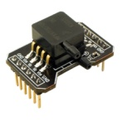
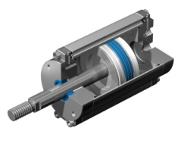

1.4 Embedded Applications
Microcontrollers are widely used in embedded applications
I/O Intensive: sensors, actuators, commands, status
Real Time: time constraints must be met for correct operations
Simple or no operating system and services
pressure sensor
I/O
A/D
Memory
D/A
actuator
valve
CPU
parallel out
serial in
Operational Characteristics differ from information based systems
Operate continuously for long periods of time
Operate in harsh environments: temperature, shock, vibration, moisture
Failure can cause Property damage or injury

Slide 38
Summary of Main Points
Functional Components of Von Neumann Architecture
Hardware Components
Machine Language vs Assembly Language
Instruction Cycle
Program Basics

Slide 39
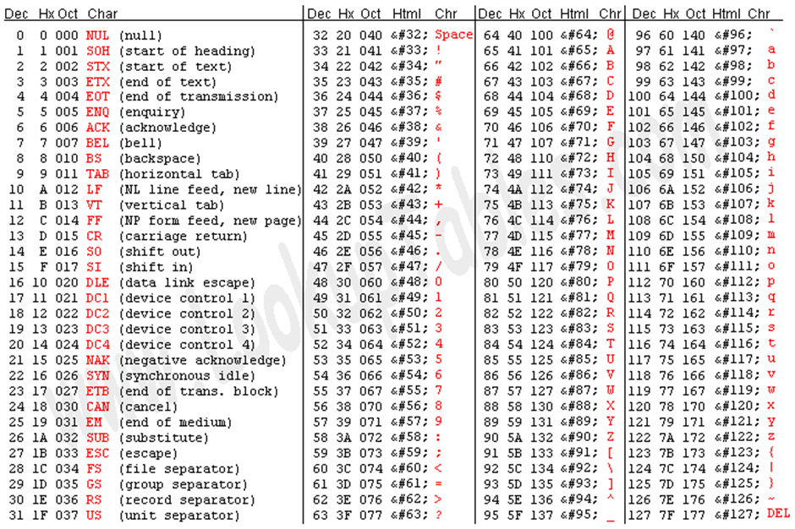

Slide 40
DECIMAL | BINARY | 1’s Compliment | 2‘s Compliment
-8 | 1000 | 0111 | 1000
-7 | 1001 | 0110 | 0111
-6 | 1010 | 0101 | 0110
-5 | 1011 | 0100 | 0101
-4 | 1100 | 0011 | 0100
-3 | 1101 | 0010 | 0011
-2 | 1110 | 0001 | 0010
-1 | 1111 | 0000 | 0001
0 | 0000 | 1111 | 0000
1 | 0001 | 1110 | 1111
2 | 0010 | 1101 | 1110
3 | 0011 | 1100 | 1101
4 | 0100 | 1011 | 1100
5 | 0101 | 1010 | 1011
6 | 0110 | 1001 | 1010
7 | 0111 | 1000 | 1001

